Slide 1




Isabel.
Camilio.
Nicole.
Diabetes
In the U.S.A.
Taking a look at the data.

Slide 2




Project Overview
How does change in insulin price compare to change in GDP?
In California, how does diabetes prevalence change over time?
In California, does a particular race have more diabetes than others?
Is California an outlier compared to other states in regard to diabetes prevalence?
Are diabetes deaths correlated with poverty, GDP, population, or employment?

Slide 3




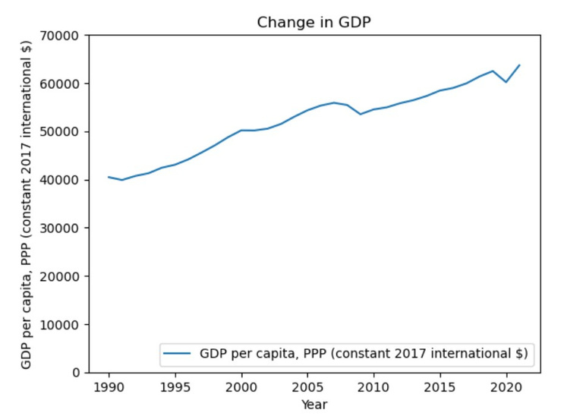
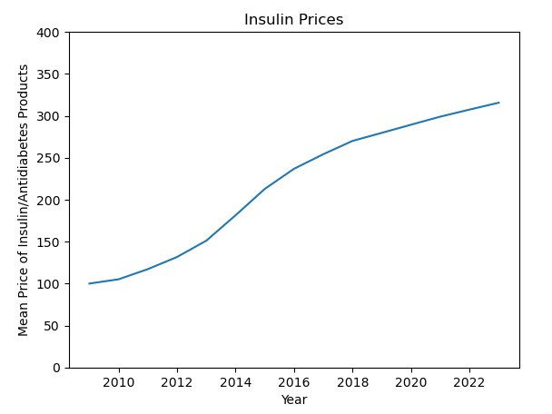
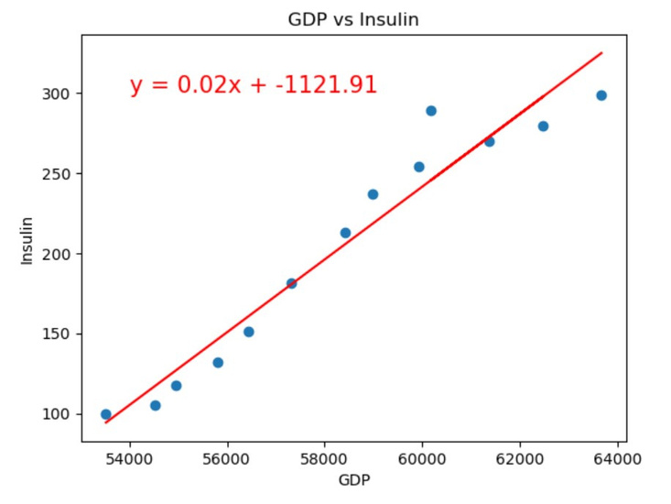
Insulin Price
vs. GDP
GDP per Capita has increased
from 1990 to 2020
Prices of insulin/antidiabetic products have increased
from 2010 to 2022
Strong correlation between
GDP and insulin prices
2010 - 2020

Slide 4
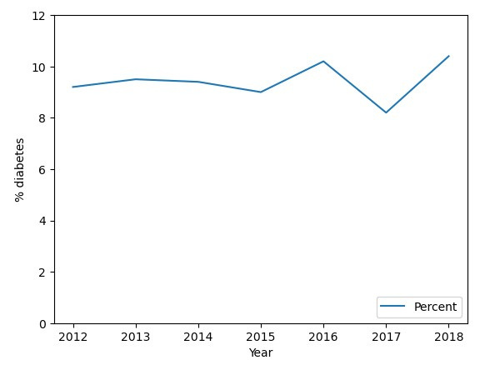

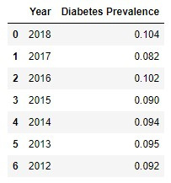

How does California diabetes prevalence change overtime?
1.2 % increase : overthinking the number?

Slide 5
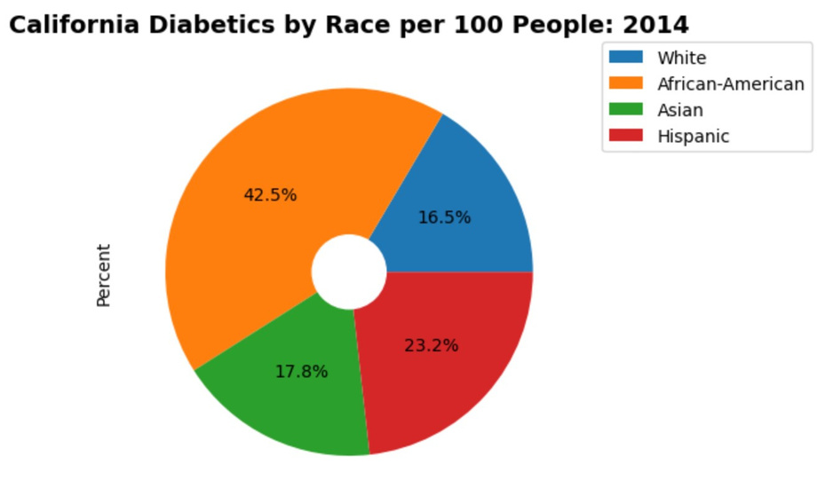
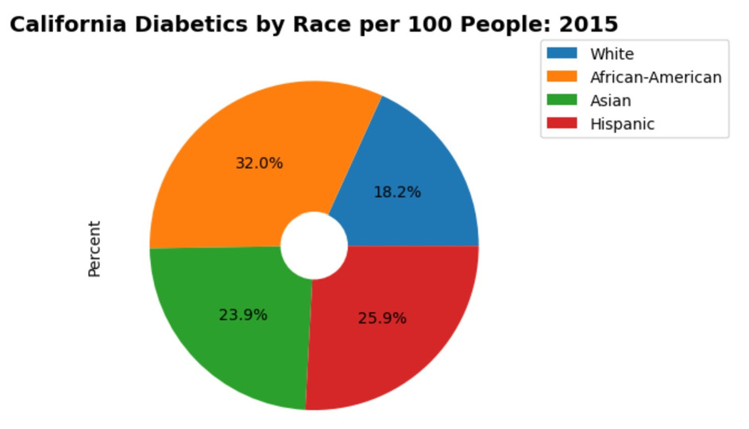
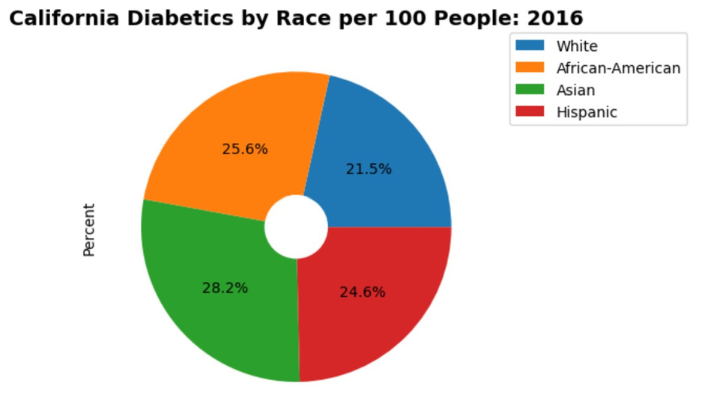
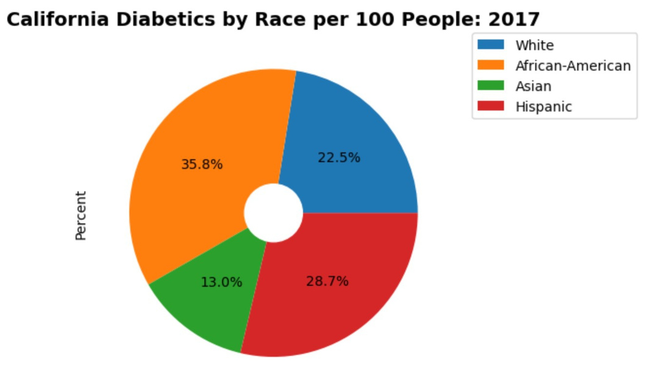
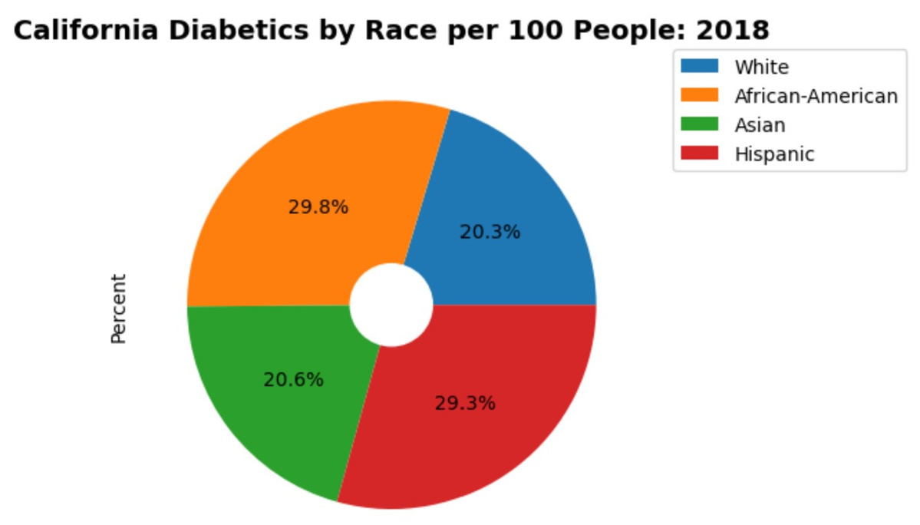
California
Pie Charts:
Per year,
By Race

Slide 6

California Pie Charts: Per year, By Race

Slide 7
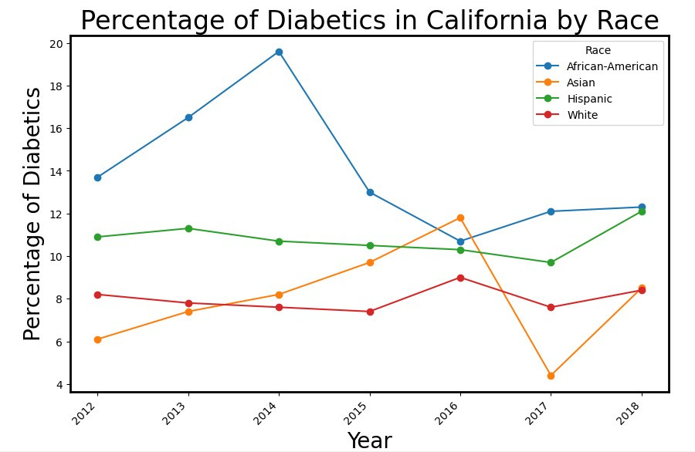
In California, does a particular race have more diabetes than others?
Target Audience #3
List their key details.

Slide 8
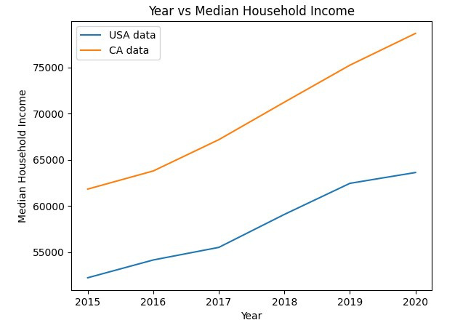
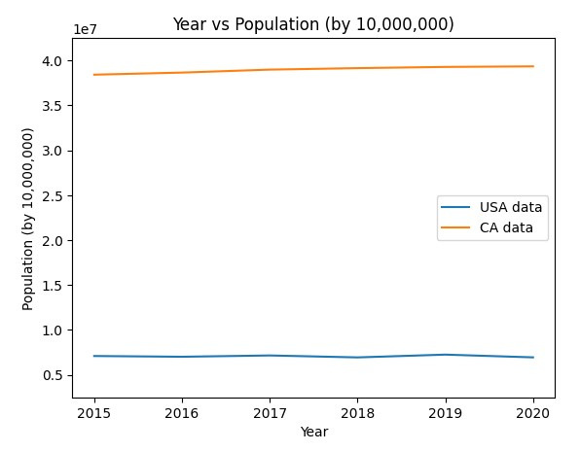
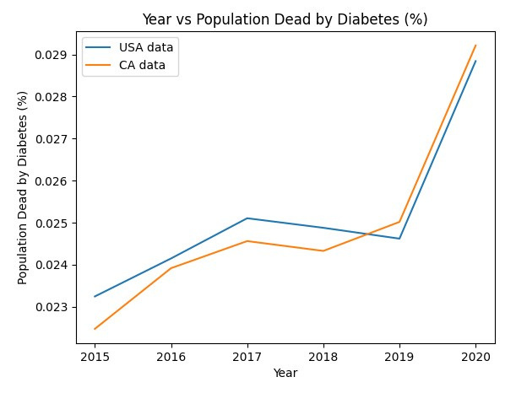
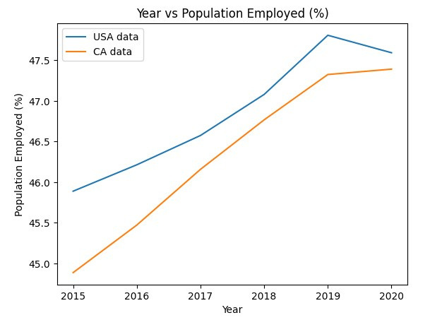
California vs.
USA

Slide 9
California vs.
USA

Slide 10
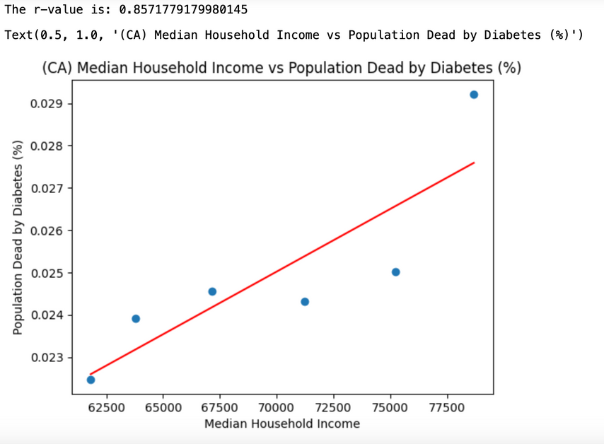
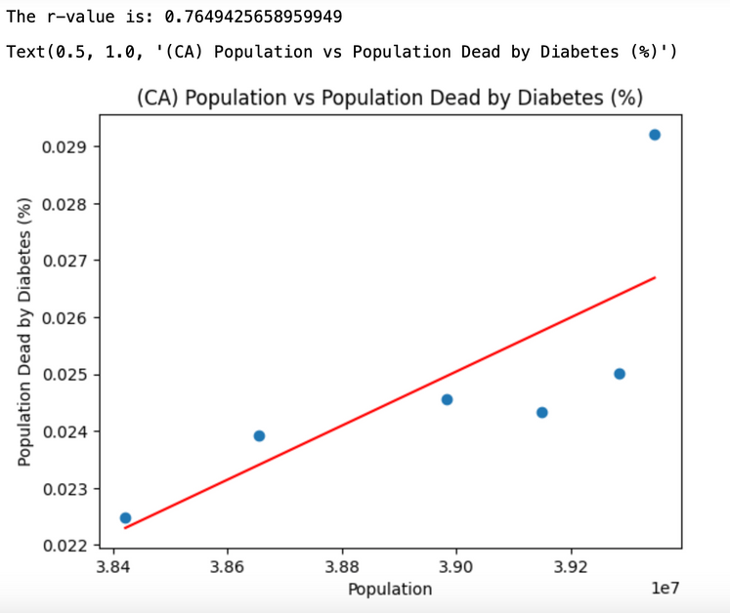

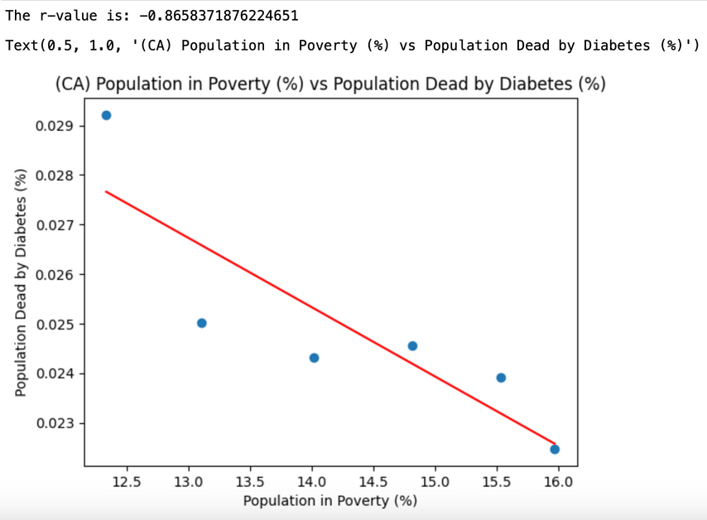
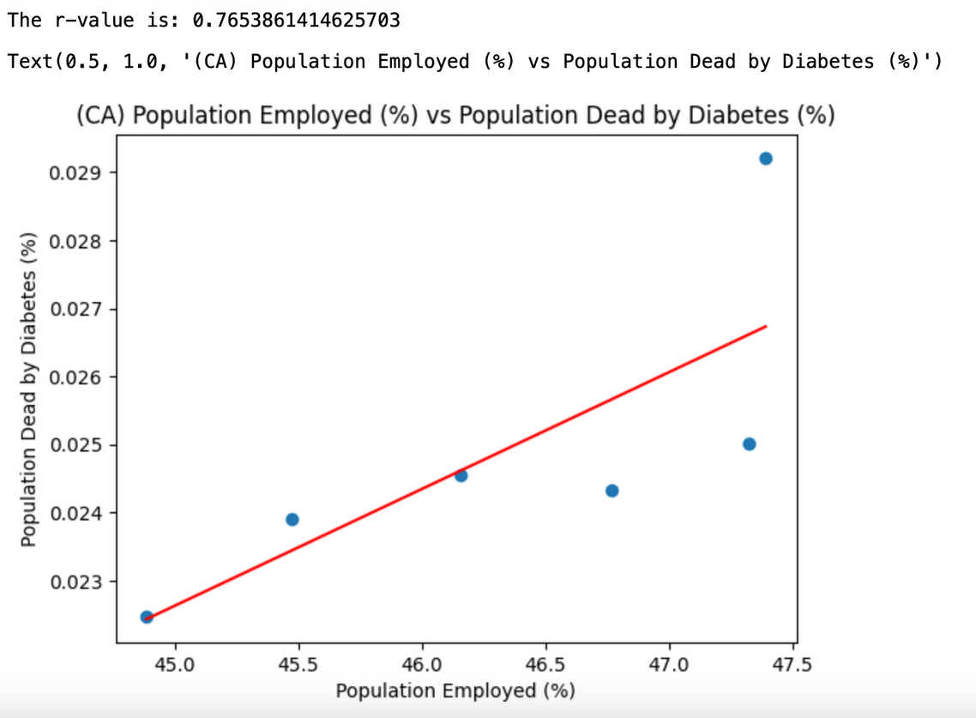
California

Slide 11
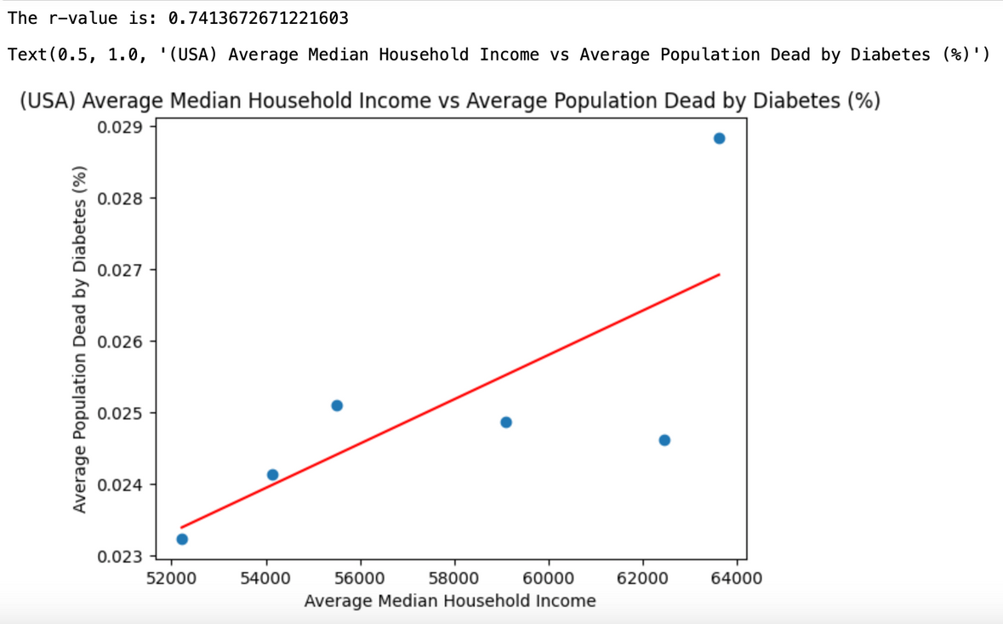
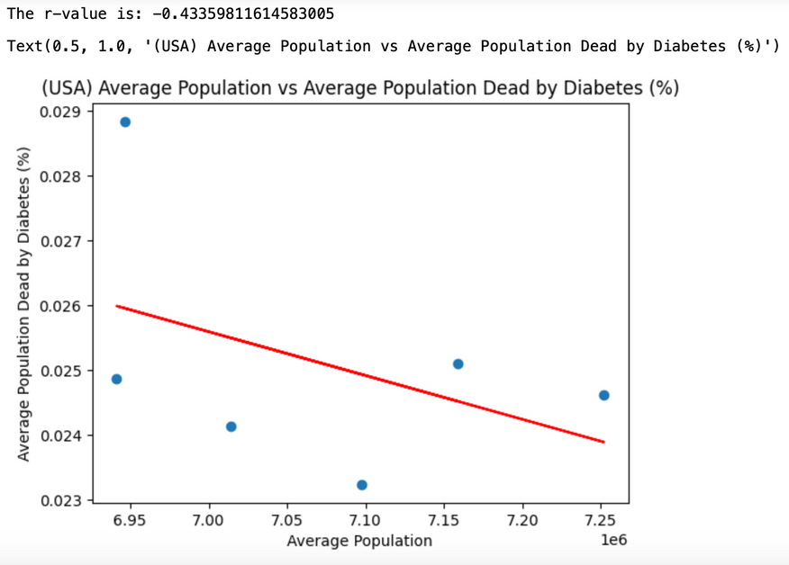
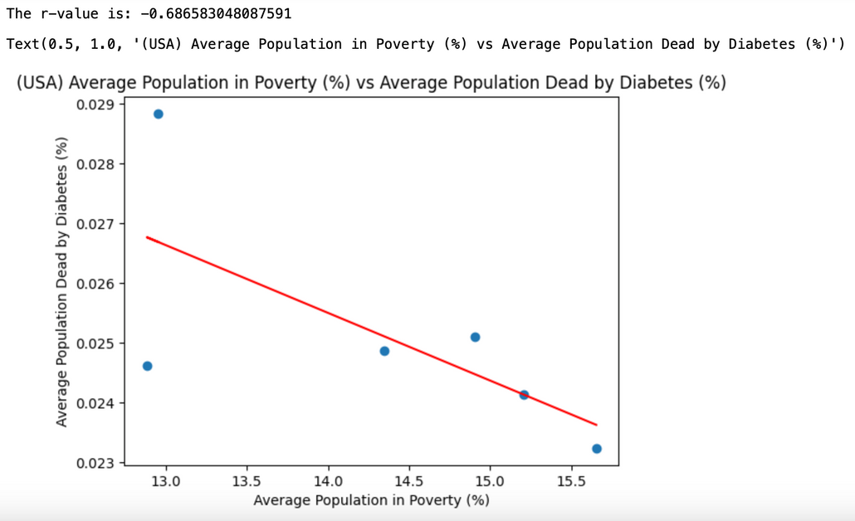
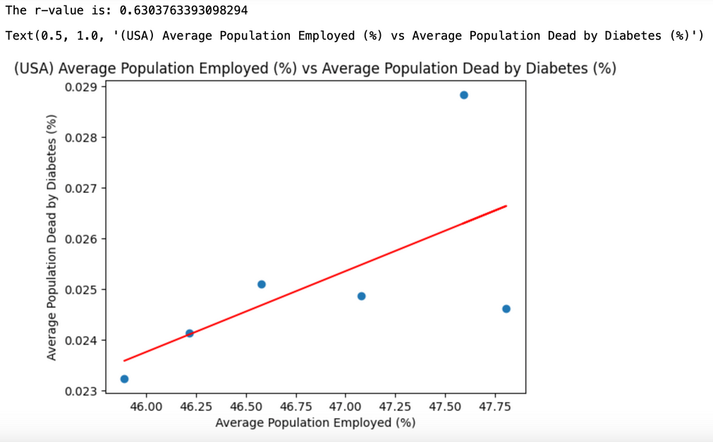

USA

Slide 12
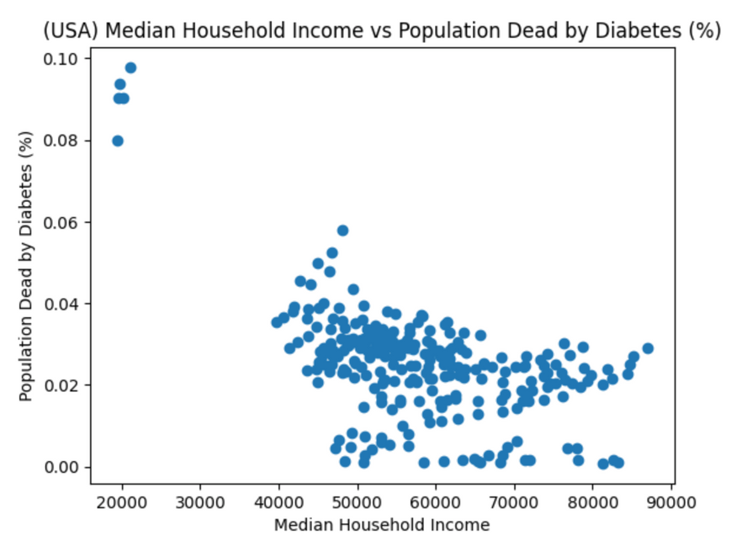
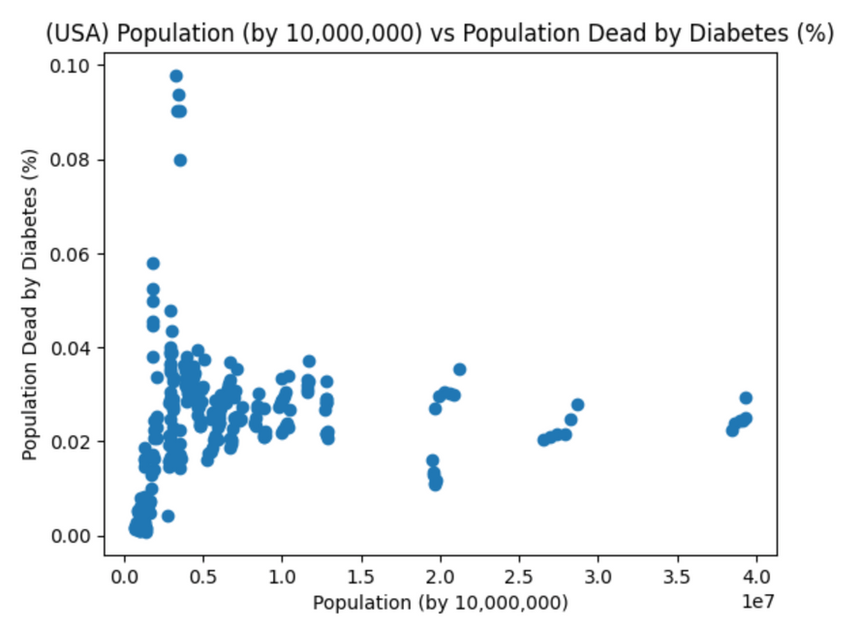
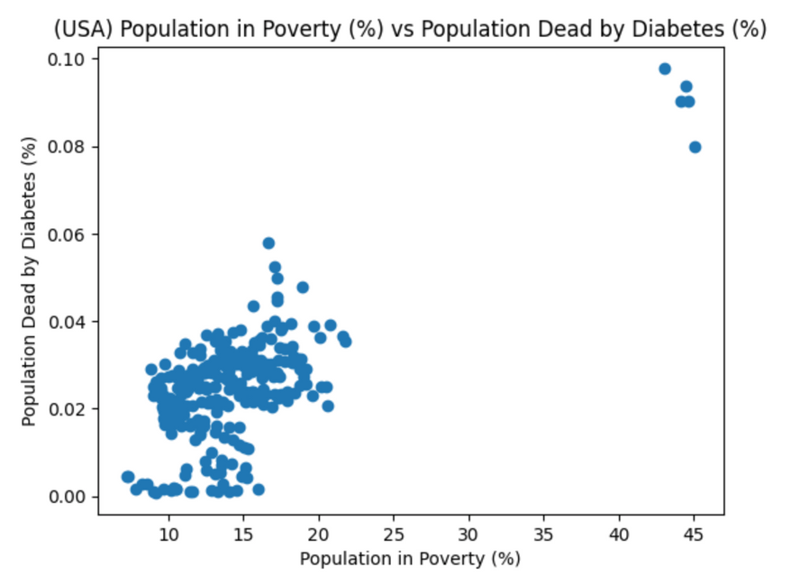
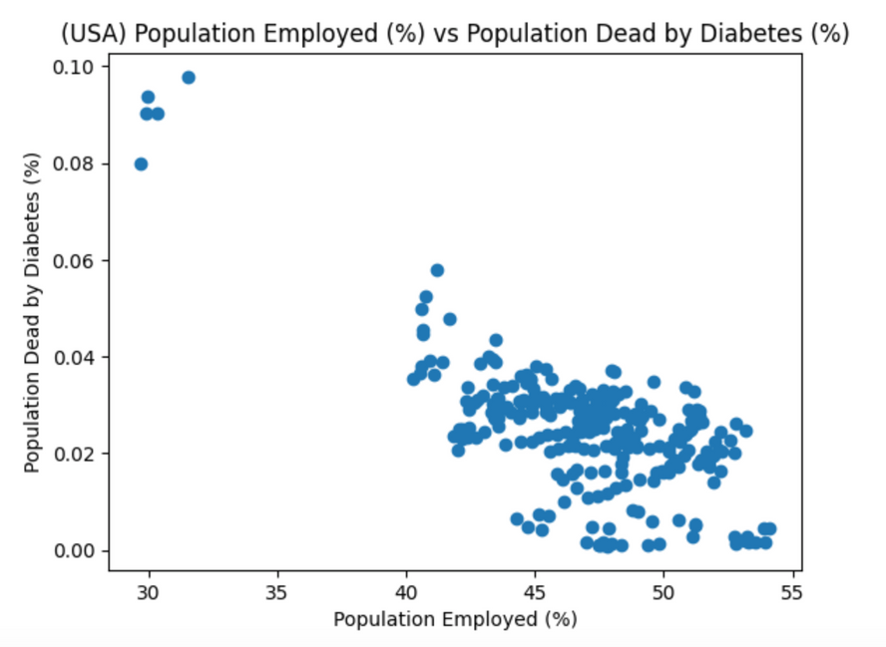
USA

Slide 13
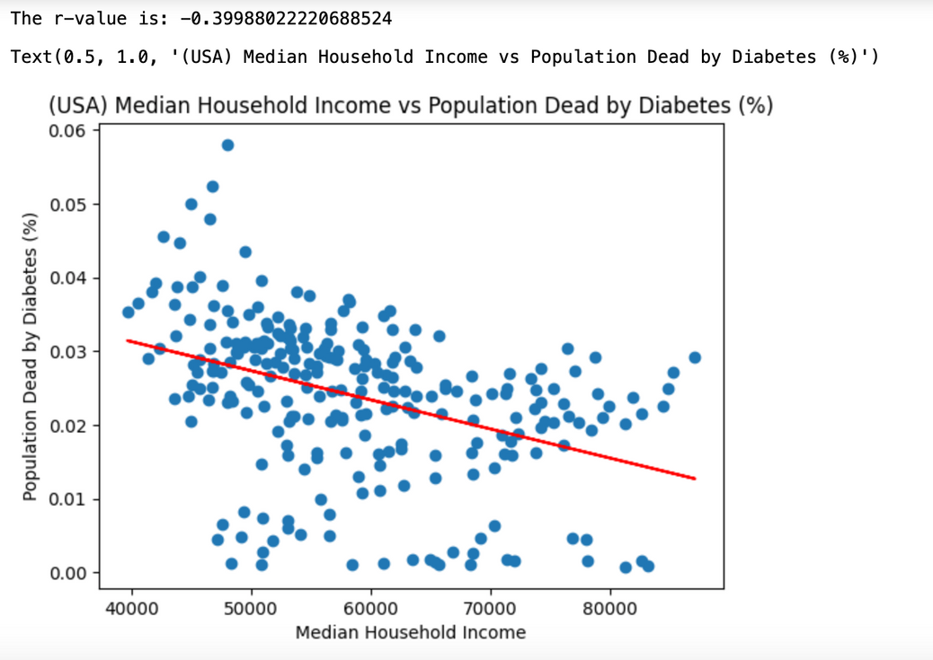
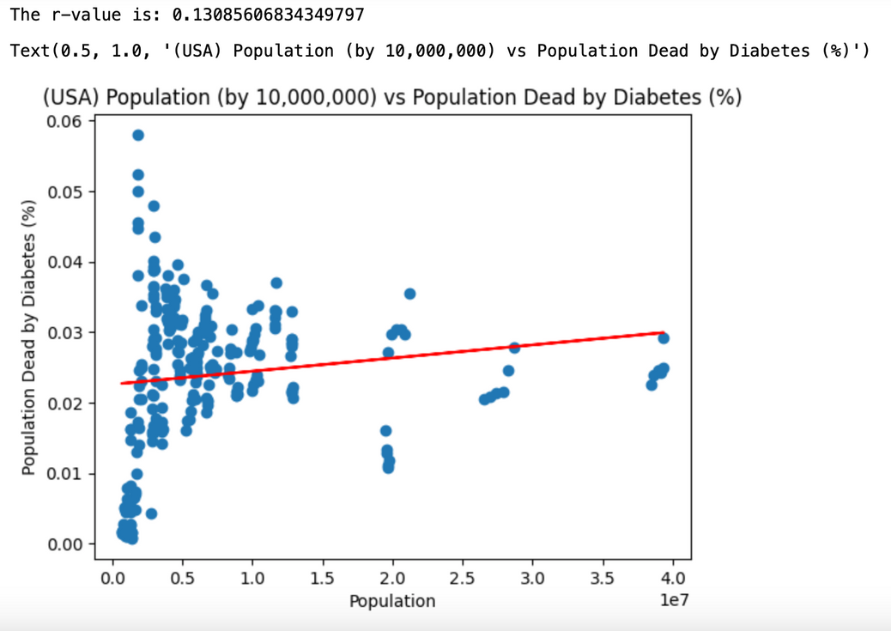
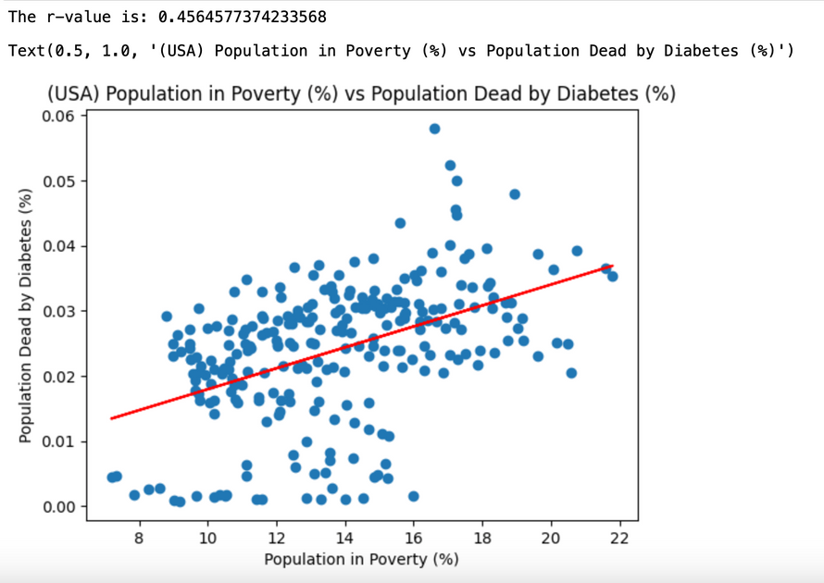
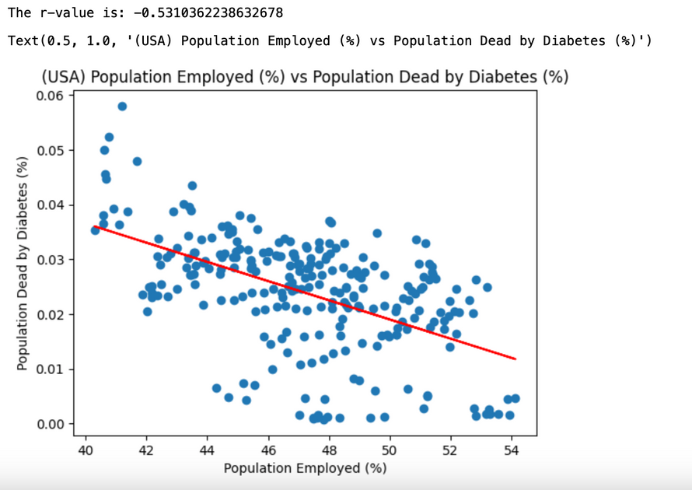
USA

Slide 14

Deeper
Look

Slide 15

Deeper
Look

Slide 16

Thank you
Overall, diabetes prevalence is increasing.
However, California is doing better compared to the rest of the country.

Slide 17


https://fred.stlouisfed.org/series/WPU06380103
https://ourworldindata.org/grapher/diabetes-prevalence-vs-gdp-per-capita
https://data.ca.gov/dataset/adults-with-diabetes-per-100-lghc-indicator
https://catalog.data.gov/dataset/weekly-counts-of-death-by-jurisdiction-and-cause-of-death
https://github.com/datamade/census
https://dof.ca.gov/reports/demographic-reports/american-community-survey/#ACS2018x1
Resource
PAGE

